Slide 1
Python GUI Calculator

Slide 2
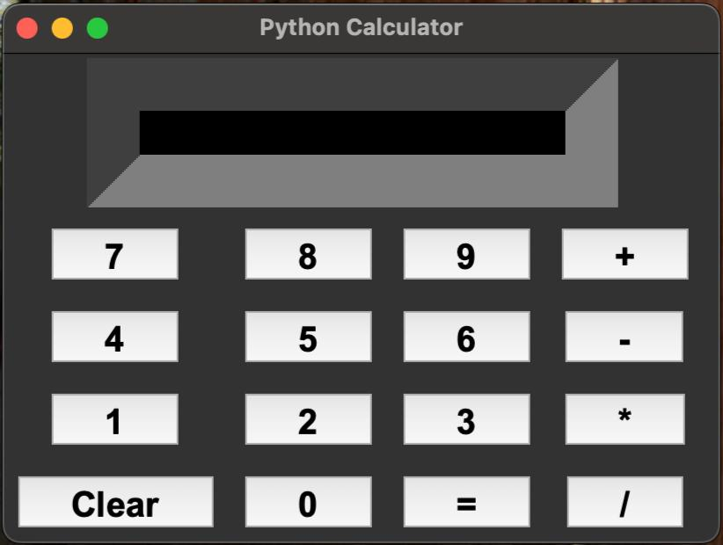
Python GUI Calculator is a calculator application built using Python programming language that features a graphical user interface(GUI), allowing me, to interact with the calculator by clicking buttons on the screen to input numbers and operations, rather than typing commands in a text-based interface.
Most commonly, this GUI is created using the built-in ''tkinter" module in Python, which provides basic widgets like buttons and display areas to build the calculator interface.

Slide 3
02/17/2025
Key Points about a Python GUI Calculator
Functionality- Performs basic arithmetic operations like addition, subtraction, multiplication, and division.
Interface elements- includes buttons for numbers, operators(+,-,*,/) decimal point, clear/reset button, and a display area to show the result.
Library used- Typically utilizes the "tkinter" module from the Python standard library to create the GUI.
3

Slide 4
02/17/2025
How it works
I have Imported the "tkinter"" module
I have created a main window for the calculator
I have added widgets like buttons and labels to the window
I have defined buttons to handle button clicks, which perform the calculations based on the inputs and display the result.
4

Slide 5
Features and Layout Features and Layout
02/17/2025
Equation display area
A large, clear area at the top of the application window where I can see current equation(input) and the result after calculations.
This area should dynamically update as I pressed buttons.
Clickable Buttons
Numeric Buttons (0 to 9)- These buttons have allowed me to input numbers into the equation display.
Mathematical Operation Buttons- Addition(+), Subtraction(-), Multiplication(*) and Division(/). These buttons have allowed me to specify the type of operation in the equation.
Equal Button(=)- This button has allowed me execute the calculation and show the result.
Clear Button(C)- This button will clear the equation display area, allowing me to start over with a new equation.
5

Slide 6
Functionality
02/17/2025
Addition- When the "+" button is pressed, it adds the numbers to the current equation string in the display.
Subtraction- When the "-" button is pressed, it subtracts the number from the current equation string.
Multiplication- When the "*" button is pressed, it multiplies the number with the current equation.
Division- When the"/" button is pressed, it divides the current equation by the given number.
Equal Button(=)- The "=" button will compute the result of the equation by evaluating the mathematical expression.
Clear Button(C)- The "C" button will clear the display area, allowing user to start fresh
6

Slide 7

02/17/2025
Learning Outcome
Understanding GUI Programming
Introduction to GUI frameworks-I learnt how to work with libraries like tkinter, to create Graphical User Interfaces(GUIs) in Python.
Widget and Layout Management- I understood how to use buttons, labels, text fields, and other widgets to interact with users and how to organize them in a window.
Event Handling
Button click events- I learnt how to capture user actions (like button clicks) and trigger functions or methods in response.
Callbacks and Event Bindings- I understood how to link actions to specific GUI events, such as pressing the "equals" button to perform calculations.
7

Slide 8
02/17/2025
Working with Function
Building Functionality into Applications
I implemented core arithmetic functions(addition, subtraction, multiplication, division) for a working calculator.
I learnt how to design the logic to handle input, calculate results, and display them in the GUI.
Improving Problem-solving Skills
I developed problem-solving skills by designing a user-friendly interface and wrote the necessary backend code to handle mathematical operations.
I implemented error handling such as preventing division by zero or handling invalid inputs.
8

Slide 9
02/17/2025
Managing Application Layout- I learnt to organize components, and create a neat, user-friendly interface by using layout management tools(e.g., tkinter)
I understood the importance of intuitive design for effective usability.
Mathematical Logic Implementation-I gained experience in implementing the logic for handling basic mathematical operations and their order of precedence.
Debugging and Testing-I improved my debugging skills by identifying and fixing issues in calculator's logic or GUI design and tested different scenarios to ensure that the calculator behaves correctly including large numbers and decimal values.
8

Slide 10
02/17/2025
Working with State and Variables
I learnt how to manage state in an application by storing and updating variables that represent the current input and result.
I understood how to work with strings and numbers, converting between the two as needed.
Visual Studio code
I have also used Visual Studio code(VS code)which is a popular code editor that can be effectively used to build a Python-based GUI calculator. It is lightweight, flexible, and supports many extensions which makes it excellent choice for Python development.
10

Slide 11

02/17/2025
GitHub
Using GitHub in a Python GUI Calculator, I have learnt how to provide version control, collaboration and sharing codes with others.
Version control- I have learnt how to track every change to my python calculator, even if I want to revert to a previous version, GitHub makes it easy to roll back.
Branching- I have also learnt to work on new features like adding advanced functions or improving GUI, and have also learnt to create separate branches for each feature, which can also be merged into the main branch.
Collaboration-GitHub is a great tool for collaboration, while working on projects with others. I have learnt that each person can work on different features or bug fixing and submit their changes via pull requests. This has allowed me to review and merge changes easily ensuring everyone's work stays synchronized.
11

Slide 12
02/17/2025
Code Sharing
I have learnt that GitHub is the ideal platform to share code with the community or open-source my project. I can even push my code to a repository, others can also contribute improvements, and create their own versions
Issues and Documentation
I have learnt how to encounter bugs, and even how to add new features to my calculator. I can even open issues on GitHub to track and manage tasks.
Continuous Integration(CI)
GitHub has integrations with CI tools like GitHub actions, which allows me to automatically test my Python code every time I push changes. This ensures my calculator is working smoothly as expected.
12

Slide 13
02/17/2025
Application Development using Python Programming Language
I have learnt how to develop applications with Python using tkinter which is a popular choice for creating Graphical User Interfaces(GUIs) because it is simple and built into the standard Python library.
Tkinter also provides a set of tools and widgets, that has helped me to create windows, buttons, labels which has made it easy for me to design desktop applications.
13

Slide 14
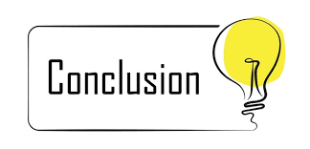
02/17/2025
Conclusion
I had already installed Python and tkinter can be used bundled with Python, so no additional installation was required.
tkinter helped me to create complex applications, by combining multiple widgets, creating classes, managing events, and customizing the layout.
tkinter is perfect for desktop application along with Python's power, I have learnt to integrate databases, file handling, and use other advanced features into my tkinter project.
<number>

Slide 15
02/17/2025
Presentation created By Aditya
<number>

Slide 16
02/17/2025
THANK YOU
<number>

